Slide 1
Briefing Template AFROTC Detachment 510
PHIL ANDRUS, C/Lt Col, AFROTC

Slide 2
Overview
Content
Pictures
Format

Slide 3
Content
Will be direct
Will be concise
Is meant to keep you on topic, not spell out entire brief

Slide 4
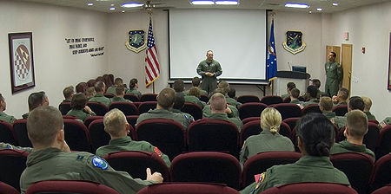
Pictures
May be used with discretion
Will be related to topic
Will not distract audience

Slide 5
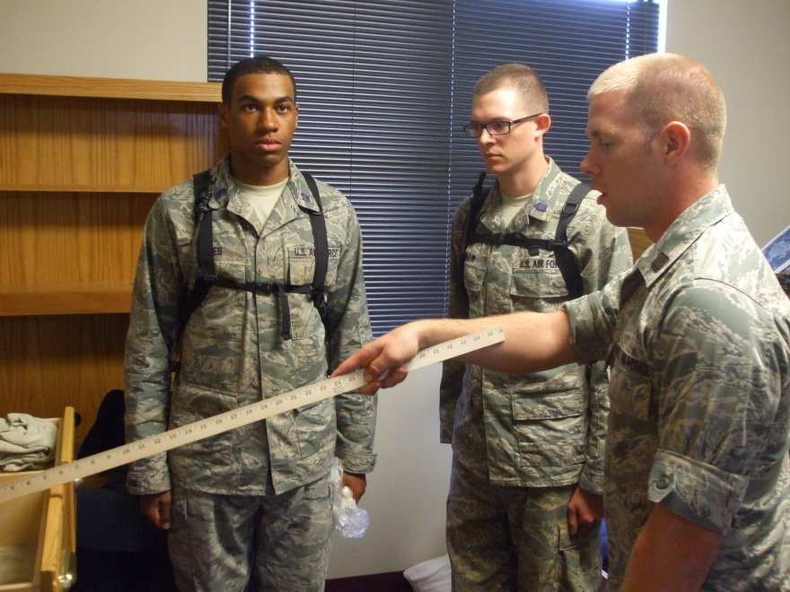
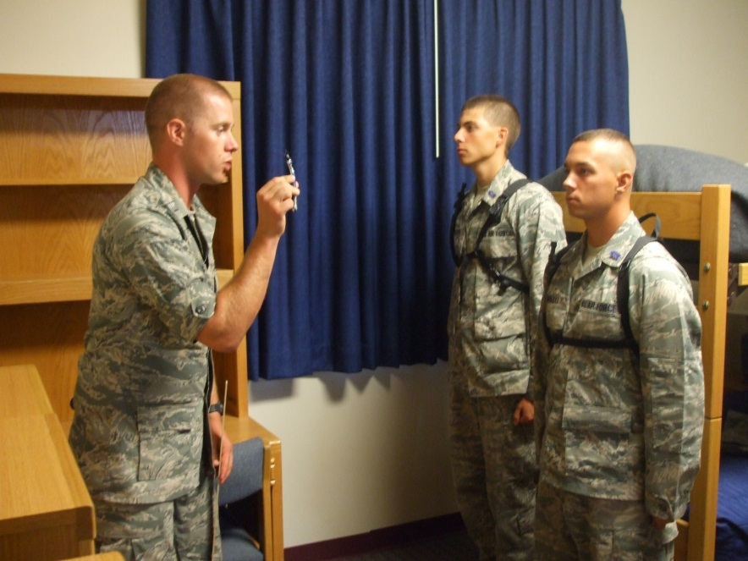
Format
Must exactly replicate this presentation
STANDARDIZE, STANDARDIZE, STANDARDIZE!!!

Slide 6
Summary
Content
Pictures
Format

Slide 7
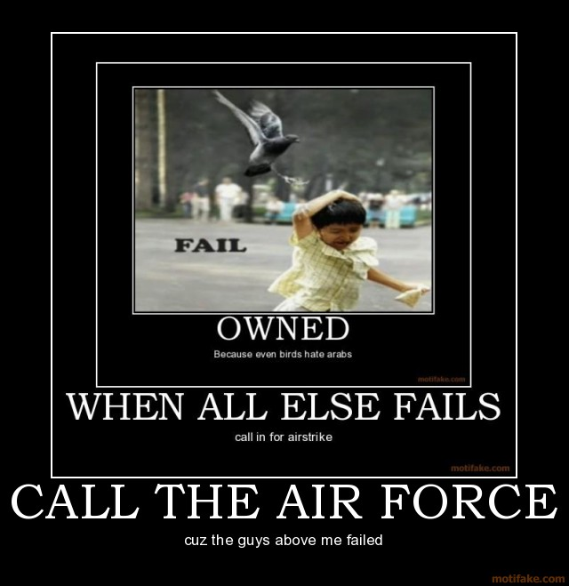
Questions

